Slide 1

RUM Analytics Platform
Irixa Vales Torres
Antonio Lugo Alicea
CIIC4151
UNIVERSIDAD DE PUERTO RICO
MAYAGUEZ
Notes:
Greetings!
name and name talking about RAP

Slide 2
Project Motivation
This project aims to find a correlation between external events that affect students and their academic performance
We hope to find a correlation between when analyzing GPA is some anomaly at the time of a significant event or no change in data trends
RUM Analytics Platform UPRM - CSE

Slide 3
Objectives
Obtain student data for 10% of the population of UPRM students
Design algorithms to analyze data and draw conclusions useful to UPRM administration
Create a data visualization platform that includes reports and dashboards which showcase the analytics
RUM Analytics Platform UPRM - CSE
Notes:
1 Obtain information about at least 10% of enrolled students.
1 Get records from university through OPIMI dating back to 2010 until current year, and store them in a database for our use
2 Create a model that predicts how external events affect students with at least an 80% accuracy.
3 Create a series of dashboards and reports using a visualization tool that allows users to see clear correlations in the dataset
3 Allow platform users to view their own individual analytics, including data since the year they enrolled or since 2010 (whichever is more recent)

Slide 4
Solution Overview
Data acquisition
Exploratory data analysis
Visualize results
RUM Analytics Platform UPRM - CSE
Notes:
Data:
university records
survey disseminated
EDA:
used jupyter notebook and powerbi
Visualize:
powerbi and jupyter

Slide 5
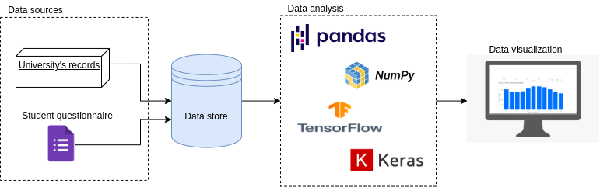
System Architecture
RUM Analytics Platform UPRM - CSE

Slide 6
Data Acquisition: University’s records (2010-2020)
Student’s Admission
Program admitted to
Gender
IGS
Coming school
Type of school
Year of admission
Grades by semester
Course
Grade
GPA by semester
Graduations by semester
Internal and External Transfers by semester
RUM Analytics Platform UPRM - CSE
Notes:
IGS: Measure calculated from high school gpa and college board to determine if a student is adept enough for a specific major

Slide 7
Data Acquisition: University’s records (2010-2020)
Total students: 22,195
Total grades: 793,615
Total GPA: 187,151
Total graduations: 6,458
RUM Analytics Platform UPRM - CSE
Notes:
Complete population of the university from 2010-2020
10 times our desired outcome

Slide 8
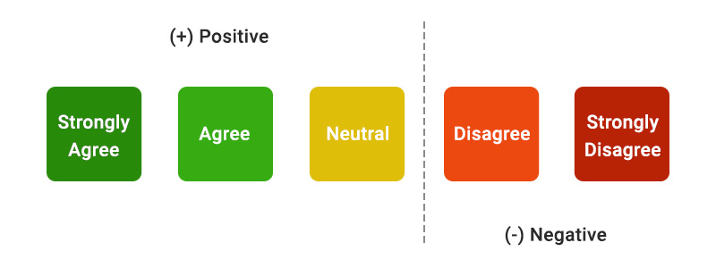
Data Acquisition: Students’ Sentiment through Questionnaire
Historical events:
Students strikes (2016)
Hurricanes Irma and Maria (2017)
Frequent power outages (2018-2019)
Frequent earthquakes (2020)
COVID-19 pandemic (2020)
Questions:
Q-1: How much were your study habits affected by the following events?
Q-2: How was the amount of academic work you received affected?
Answers:
Likert scale {1, 2, 3, 4, 5, 6}
RUM Analytics Platform UPRM - CSE
Notes:
Likert scale {1, 2, 3, 4, 5, 6}

Slide 9
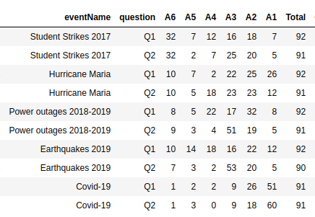
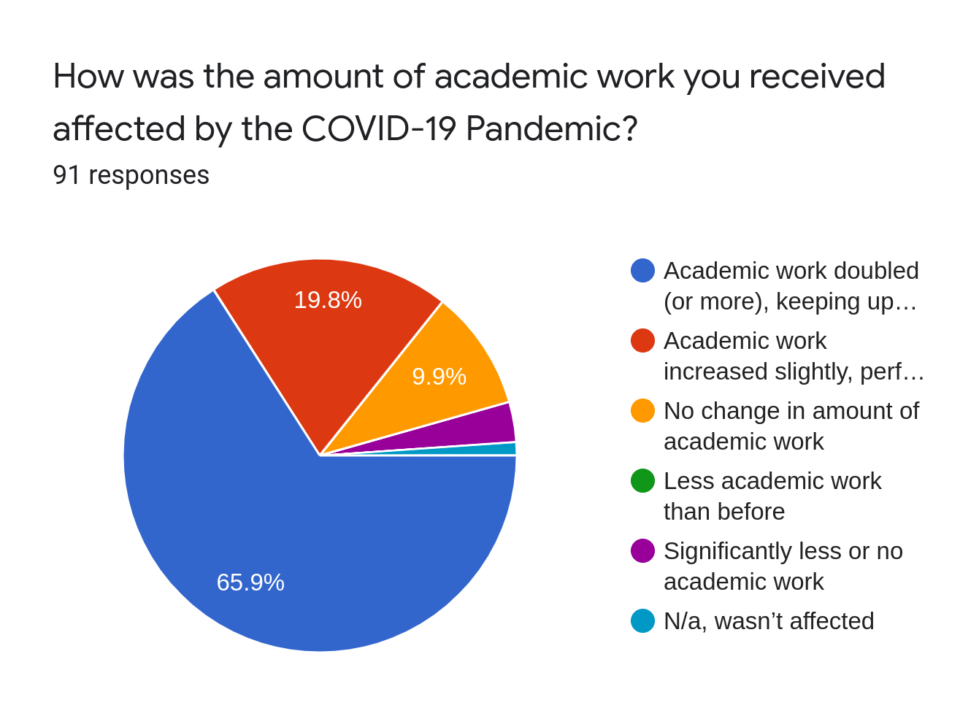
Data Acquisition: Questionnaire Results
RUM Analytics Platform UPRM - CSE
Notes:
Disseminated through:
university email system
social media
reaching out to individuals
92 responses
Disclaimer: 92 isn’t statistically significant, we assume similar ratios for a bigger response

Slide 10
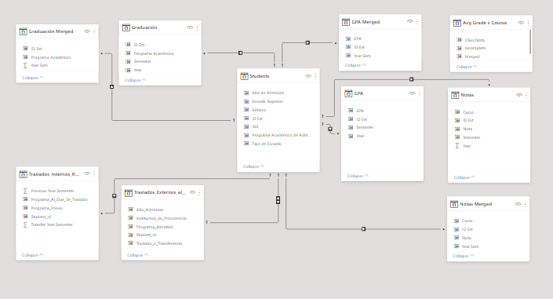
Data Model
RUM Analytics Platform UPRM - CSE

Slide 11
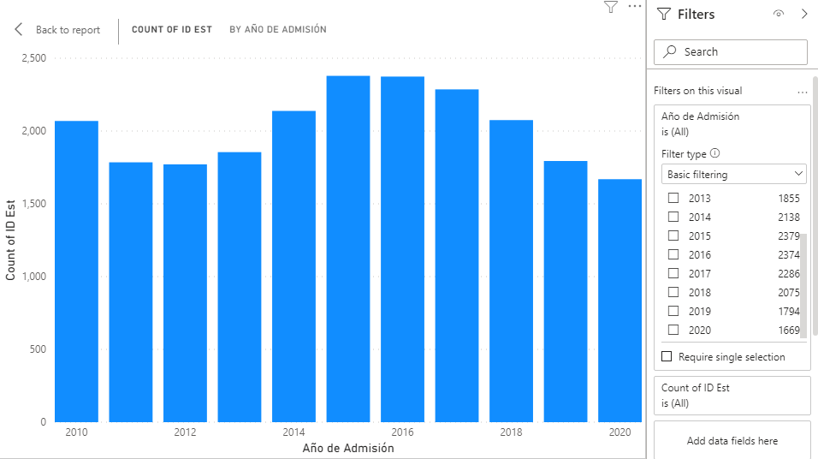
Results
RUM Analytics Platform UPRM - CSE

Slide 12
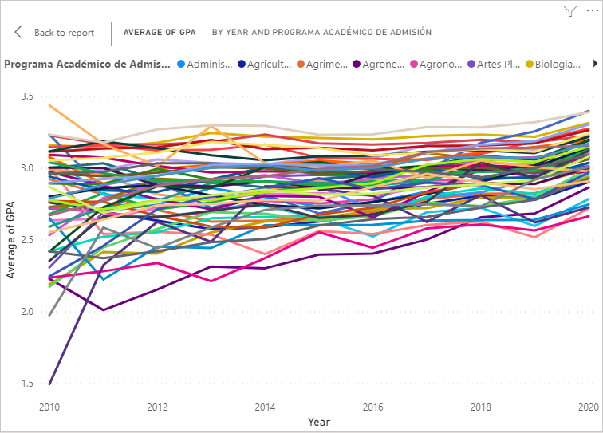
Results
Average GPA per program has increased over time by xx%
RUM Analytics Platform UPRM - CSE
Notes:
we see correlation
cant assume causation

Slide 13
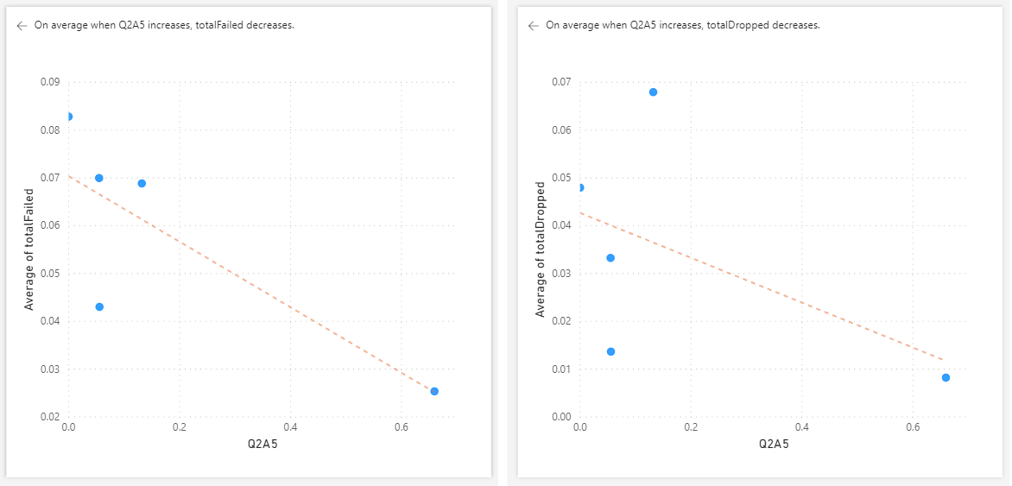
On average when more students answer 5 to Q2, both total drops and total failed courses decrease
Q2: How did the amount of academic work change?
A5:
RUM Analytics Platform UPRM - CSE
Notes:
we see correlation
cant assume causation

Slide 14

Conclusions
Get access to student data for a reasonable population of UPRM students
Design algorithms to analyze data and draw conclusions useful to UPRM administration
Create a data visualization platform that includes reports and dashboards which showcase the analytics
RUM Analytics Platform UPRM - CSE

